Slide 1
Product requirement document
Distance based on Two locations or Coordinates using Google Distance API

Slide 2
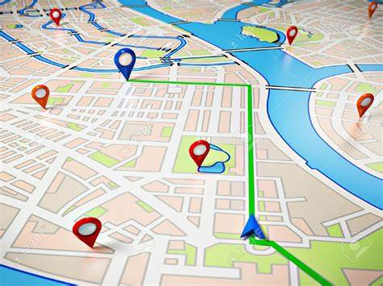
INTRODUCTION
High-Level purpose of product
Actors/users
Features/use cases
Dependencies

Slide 3
High-Level purpose of product
The purpose of the product is to provide a distance calculator that allows users to find the distance between two locations and display the route on a map. It also provides images of the origin and destination locations.
Geo Distance Finder is to provide a reliable and efficient solution for determining the distance between two locations.
It aims to offer accurate distance measurements, whether in terms of physical distance (such as kilometers or miles) or travel.

Slide 4
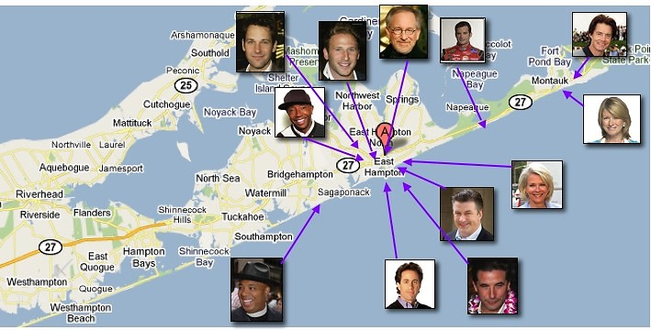
Actors/users
Geo DistanceFinder targets a wide range of users, including but not limited to:
Travelers and tourists: To plan routes and estimate travel time.
General Users: People who need to calculate the distance between two locations for various purposes, such as planning a trip, estimating travel time, or determining the distance for any other reason.

Slide 5
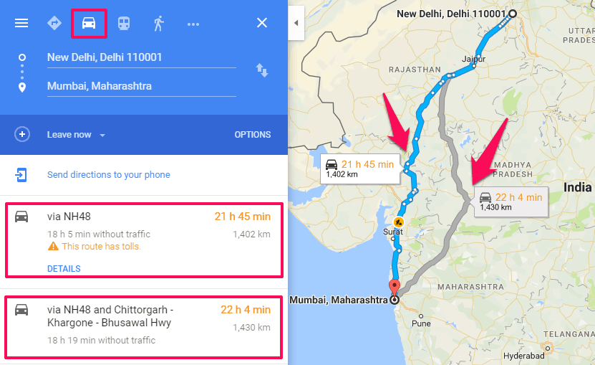
Features/use cases
Distance Calculation: Users can enter the origin and destination locations and calculate the distance between them using the Google Maps API. The result includes the distance and the estimated duration of travel.
Map Display: The calculated route and directions are displayed on a map using the Google Maps API, providing a visual representation of the path between the two locations.

Slide 6
3.Image Display: The product retrieves images of the origin and destination locations using the Google Street View API and displays them to give users a visual representation of the places they are calculating the distance between.
4.User-Friendly Interface: The product has a responsive and user-friendly interface implemented using Bootstrap CSS. It includes input fields, buttons, and visual elements to enhance the user experience.
5.Error Handling: The product handles errors gracefully by displaying appropriate error messages if there are any issues with the distance calculation or map display.
6.Auto-completion: The input fields for origin and destination locations support auto-completion using the Google Places Autocomplete feature, which helps users enter accurate and complete addresses more easily.

Slide 7
Dependencies
Bootstrap CSS: The product uses Bootstrap CSS for styling and responsive design.
2.jQuery: The product utilizes the jQuery library for DOM manipulation and event handling.
3.Popper.js: Popper.js is used as a dependency for Bootstrap to handle popovers and tooltips.

Slide 8
4.Google Maps API: The product integrates with the Google Maps API to calculate distance, display maps, and retrieve street view images.
5.Google Places Autocomplete API: The product utilizes the Google Places Autocomplete API to provide auto-completion functionality for the origin and destination input fields.

Slide 9


